Slide 1
CARE
CPR & CPR+ Workshop
PRAY
Where there is no vision, the people are unrestrained Proverbs 29:18 (NASB)
REACH OUT

Slide 2
Schedule
9:00 Greetings/ Introduction
9:15: It starts with who we are
Big Issues
CPR Overview Blessing More People More
  Caring
    Break out
  Praying
    Break out
  Reaching out
    Break out
CPR Next Steps
Break (Around 10:15)
CPR+ Overview: Developing Leaders
Caring+
  Break Out
Praying+
  Break Out
Reaching Out+
  Break Out
Noon: Dismiss

Slide 3

CPD Mission
We exist to build Christ’s Kingdom in the CPD and the World.
We will accomplish this by resourcing, equipping, multiplying and sending (REMS) believers, leaders and churches.

Slide 4
Our Goal: Multiplying Your Influence and Impact (24/7) at home, at school, at work, at church and in the community
District Vision
Multiplying Christ-centered, Spirit-filled, healthy, strategic leaders
  Spiritual Leadership:
  Deeper Life
  Christ-centered
  Spirit-filled
  Healthy
Strategic Leadership:
Broader Influence and Impact
  Strategic
  Leaders
Teach us to number our days, that we may gain a heart of wisdom. Psa 90:12 1

Slide 5
Christ-centered Life and Leadership:
The Lord’s Prayer
Our Father, who art in heaven, hallowed be thy name;
thy kingdom come;
thy will be done;
on earth as it is in heaven.
Give us this day our daily bread.
And forgive us our trespasses,
as we forgive those who trespass against us.
And lead us not into temptation;
but deliver us from evil.
For thine is the kingdom,
the power and the glory,
for ever and ever.
Amen.

Slide 6
It Starts with Who We Are
Christ-centered Life and Leadership
Our Father, who art in heaven, (KI)
hallowed be thy name; (KW)
thy kingdom come; (KP)
thy will be done; (KA)
on earth as it is in heaven.
Give us this day our daily bread. (KP)
And forgive us our trespasses,
as we forgive those who trespass against us.
And lead us not into temptation;
but deliver us from evil.
Kingdom Identity
Kingdom Worship
Kingdom Presence
Kingdom Authority/Power
Kingdom Practice
Christ-centered, Spirit-filled, healthy, strategic leaders

Slide 7
Addressing 3 Significant Church Issues
How do we reach our community? Outreach
How do we care for our congregation? Pastoral care
How do we develop leaders? Advancing the Great Commission in the local church, district, US, and beyond.
Our CPD Kingdom Vision:
  Helping each church to become a “Net Exporter” of workers/leaders for the harvest. Raise up 10, hire 2, and export the rest of the leaders.
  Leaders for the harvest include lay leaders as well as accredited: 1) bi-vocational, 2) part-time, 3) full-time pastors and church planters in both the US and overseas

Slide 8
CPR/CPR+
CPR Church / Community
CPR+ Leadership Development
Caring
  Knowing their “name”
Praying
  Scriptural prayers
  Asking them for requests
Reaching Out
  Text, email, coffee
Caring+
  Hearing their story / aspirations
Praying+
  Each month
  Their lives / leadership development
Reaching Out+
  Meeting each month
  One-foot Fence
  Keeping them in the Zone

Slide 9
Jesus is Our Model … (Matthew 9:35-10:1)
9:35 Jesus went through all the towns and villages, teaching in their synagogues, proclaiming the good news of the kingdom and healing every disease and sickness.
36 When he saw the crowds, he had compassion on them, because they were harassed and helpless, like sheep without a shepherd.
37 Then he said to his disciples, “The harvest is plentiful, but the workers are few.
38 Ask the Lord of the harvest, therefore, to send out workers into his harvest field.”
10:1 Jesus called his twelve disciples to him and gave them authority to drive out impure spirits and to heal every disease and sickness.
Notes:
These 99 words changed the world. We see the message of Jesus, the heart of Jesus, the vision of Jesus, and the strategy of Jesus. Here we see Jesus saying that we should pray to the Lord of the Harvest for more workers.

Slide 10
JESUS: Our Model for Life and Leadership
Jesus touched the Multitude
  Because he had compassion (he cared)
Jesus spent time with the Father
  For intimacy, direction, and Spirit-filled power
Jesus invested in the 12
  Strategy to change the world
  As a small group and one-on-one
  Each was different (Peter, James, and John)

Slide 11
CPR: Time Touching the Multitude
Jesus
You and Me
Jesus spend time with the Father
Jesus touched the multitude
Jesus invested in the 12
We spend time with the Father, the Son, and the Holy Spirit
  This is where our life and power comes from (Jn 15, Eph 5:8)
We touch the multitude through CPR
  Everywhere we go
We invest in the 12 (or 3 or 6) through CPR+
  Focused time

Slide 12
God is Going to Use You
To Bless More People More
  God is going to use you to reach those in your community. (CPR)
  God is going to use you to care for those in your church. (CPR)
To Develop Workers / Leaders for the Harvest (Lk 10:2)
  God is going to use you to develop leaders in your church. (CPR+)

Slide 13
CARING
Mt 9:36 When he saw the crowds, he had compassion on them, because they were harassed and helpless, like sheep without a shepherd.
  It starts with having the heart of Jesus.
  We live in an unshepherded world.
  You will be the only pastor many people will have.
Touching the Multitude wherever we go
  God has gone before us
  Minutes, not hours

Slide 14
Triads: CARING (5-10 minutes)
Join in groups of 2 or 3 (Not 4)
Not with someone you are related to or live with
Find out:
  What is their name?
  Where were they born?
  Where did they go to high school?
  When did they become a Christian?

Slide 15
PRAYING
“How can I pray for you?”
  Family, health, finances, work, school?
Touching Heaven and Changing Earth
Supernatural exchange
Listening and speaking
  Hearing words / Speaking words
Lord, how should I pray for this person?
  Scriptural prayers
  They will encounter God’s presence and power
Minutes, not hours (each month)
Prayers from Ephesians 1:
16: I do not cease to give thanks for you, remembering you in my prayers,
17: that the God of our Lord Jesus Christ, the Father of glory,
(#1) may give you the Spirit of wisdom and of revelation in the knowledge of him,
18: (#2) having the eyes of your hearts enlightened,
(#3) that you may know what is the hope to which he has called you,

Slide 16
Triads: Praying (5-10 minutes)
Join in same groups of 2 or 3 (not 4)
Not with someone you are related to or live with
Praying for one another:
  How can I pray for you?
  Let's pray

Slide 17
REACHING OUT
Touching the multitude
Minutes, not hours (each month)
Text, email, call, conversation
  “Praying for you today. How are things going?”

Slide 18
Triads: Reaching Out (5-10 minutes)
Join in the same group of 2 or 3 (Not 4)
Not with someone you are related to or live with
Exchange phone numbers
  Put a future date on your calendar next month to reach out with a text

Slide 19
CPR Partner (for the next 3 months)
How can I pray for you? (each month)
Reach out with a simple touch (each month)
CPR Support and Accountability
Partner #1: ______________________ Cell #_____________________
Partner #2: ______________________ Cell #_____________________

Slide 20
CPR Friends List
Church
Community
______________________
______________________
______________________
______________________
______________________
______________________
______________________
______________________
______________________
______________________
______________________
______________________

Slide 21
CPR/CPR+ and Your Church
CPR Out-reach (Evangelism)
CPR In-reach (pastoral care)
  What group and team leaders do with those they lead
CPR+ Developing Leaders
  CPR+ with those you oversee (at church or at work)
  CPR+ with others (those you work with)

Slide 22
Jesus is Our Model … (Matthew 9:35-10:1)
9:35 Jesus went through all the towns and villages, teaching in their synagogues, proclaiming the good news of the kingdom and healing every disease and sickness.
36 When he saw the crowds, he had compassion on them, because they were harassed and helpless, like sheep without a shepherd.
37 Then he said to his disciples, “The harvest is plentiful, but the workers are few.
38 Ask the Lord of the harvest, therefore, to send out workers into his harvest field.”
10:1 Jesus called his twelve disciples to him and gave them authority to drive out impure spirits and to heal every disease and sickness.
Notes:
These 99 words changed the world. We see the message of Jesus, the heart of Jesus, the vision of Jesus, and the strategy of Jesus. Here we see Jesus saying that we should pray to the Lord of the Harvest for more workers.

Slide 23
CARING+
Leaders are hand-crafted, not mass-produced.
Jesus interacted differently with Peter than with John.
You can only develop leaders well if you know them well.
Take about an hour to hear their story and aspirations:
  Where were they born?
  Where did they go to high school?
  When did they become a Christian?
  What are some hopes you have for your life and ministry going forward?

Slide 24
Triads: CARING+ (5-10 minutes)
Same groups of 2 or 3 (Not 4)
Not with someone you are related to or live with
Find out:
  What are 2-3 aspirations you have for your life and ministry for the next year or two?

Slide 25
PRAYING+
Pray for God to work in and through their aspirations
They can grow as
Christ-centered, Spirit-filled, healthy strategic leaders
God will build their leadership capacity:
  Leadership Capacity is Built through Sacrifice and Suffering
This can be a hard road, and not everyone will continue because of:
  Sacrifice and Suffering
  Distractions of Life and Work
  Lack of Focus and Discipline

Slide 26
Triads: PRAYING+ (5-10 minutes)
Same groups of 2 or 3 (Not 4)
Not with someone you are related to or live with
Find out:
  What are 2-3 aspirations you have for your life and ministry for the next year or two?

Slide 27

REACHING OUT+
Plan to meet each month one-on-one
  Check-in
  Review the last one-foot fence
  Discuss progress and moving forward
  Discuss their CPR/CPR+ work with other people
  Add tools to their toolbox
  Leave with the next one-foot fence
  Ask how you can be praying for them
  NOTE: You can also do a mix of a small group and one-on-one meeting
Coaching Framework
  Connecting with Care
  Clarifying the Goal
  Collaborating with Questions
  Creating a Plan Forward
  Closing with Purpose

Slide 28
Triads: REACHING OUT+ (5-10 minutes)
Same groups of 2 or 3 (Not 4)
Discuss:
  What do they want to move forward?
  What could be a one-foot fence or two?
    A one-foot fence is a simple step forward that is not difficult or time-consuming but one after another will result in progress forward.
  Schedule a call or meeting next month to meet.

Slide 29
ACE Model to Accelerate Development
Academic Learning (Formal and Informal)
Coaching (and Cohorts)
Experience (Practice in Real Life)

Slide 30
Using the Mini-ACE Model with CPR+
Informal Academic Learning
Simple Coaching (Support, Encouragement, Accountability)
Experience in Real Life

Slide 31
Mini-ACE Model with CPR+ Example:
Leadership Development
Informal Academic Learning
  Listen to Multiply Your Leadership podcast Episode #4: Kingdom Identity
Coaching
  How can you strengthen your identity in Christ?
Experience in Real Life
  Work on self-talk
  Remember who I am in Christ (Child of God, beloved, forgiven, secure)

Slide 32
CPR+ Leadership Development List
Developing Your List
______________________
______________________
______________________
______________________
______________________
______________________
Look at your list capacity
Plan to meet each month
Only half of your contacts will move past a few meetings.
Over time, some will not move forward

Slide 33
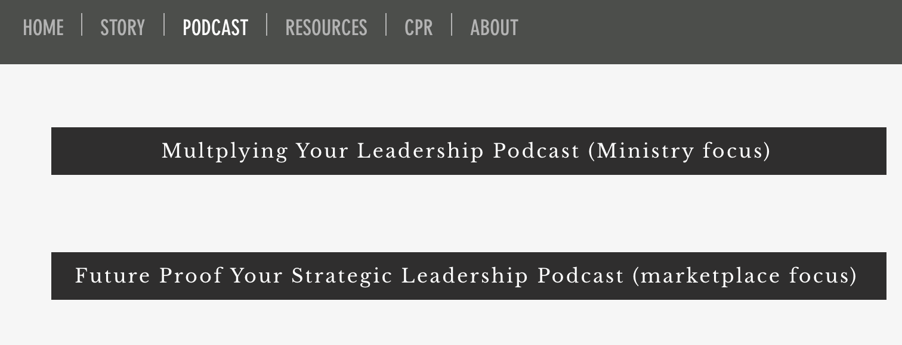
Podcast: www.clarionlife.org/podcast

Slide 34



Slide 35
Putting CPR & CPR+ into Action
Just get started…
Add some people to your CPR Friends List. Start asking names and start praying by asking or just praying silently.
Add some people to your CPR+ Leadership Development List and then start putting some coffee (meeting) times on your calendar.
CPR: “How can I pray for you? Family, health, finances, work, school?
CPR+: ”Tell me your story and some hopes for moving forward.”

Slide 36
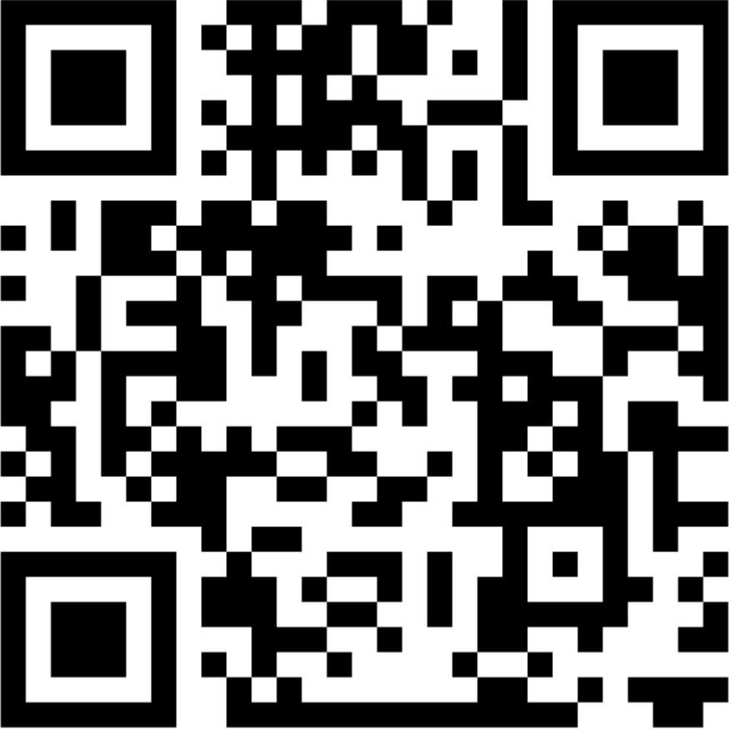
Recommended Resources
How to Pray: A Simple Guide for Normal People by Peter Greig
Master Plan for Evangelism by Robert Coleman
CPR & CPR+: How Caring, Praying, and Reaching Out Can Bless and Develop People by Rick Mann
Multiply Your Leadership Podcast
  www.clarionlife.org/podcast
Contact Rick Mann: Rick@CPDistrist.org / 615-268-0596
  If you are interested in moving into part-time or full-time vocational ministry
  School of Ministry CPD cohort
QR Code
for free PDF Book

Slide 37
Next Steps / Evaluation
Name: ______________________________
Email:_______________________________
How confident do you feel moving ahead with CPR with others?
  __________________________________________________________________
How confident do you feel moving ahead with CPR+ with others?
  __________________________________________________________________
What are some next steps for you based on today?
  __________________________________________________________________
  __________________________________________________________________

Slide 38
Evaluation
What was most helpful today?
  __________________________________________________________________
  __________________________________________________________________
  __________________________________________________________________
What could we do to improve for next time?
  __________________________________________________________________
  __________________________________________________________________
Are you open to future part-time or full-time vocational ministry? Yes / No (Circle One)
Would you recommend this workshop to a friend? (Circle One)
  1 – Not at all / 2 - No / 3 – Maybe / 4 – Yes / 5 - Strongly Yes

